Slide 1
Instrumentation drawing
Made by:- sitakshi
IC Department

Slide 2
Process controllers sketches
Pneumatic system:-A pneumatic system is a system that uses compressed air to transmit and control energy. Pneumatic systems are used extensively in various industries. Most pneumatic systems rely on a constant supply of compressed air to make them work. This is provided by an air compressor. The compressor sucks in air from the atmosphere and stores it in a high pressure tank called a receiver. This compressed air is then supplied to the system through a series of pipes and valves.

Slide 3
The advantages of pneumatic systems Pneumatic control systems are widely used in our society, especially in the industrial sectors for the driving of automatic machines. Pneumatic systems have a lot of advantages.
(i) High effectiveness: Many factories have equipped their production lines with compressed air supplies and movable compressors. There is an unlimited supply of air in our atmosphere to produce compressed air. Moreover, the use of compressed air is not restricted by distance, as it can easily be transported through pipes. After use, compressed air can be released directly into the atmosphere without the need of processing.
(ii) High durability and reliability: Pneumatic components are extremely durable and can not be damaged easily. Compared to electromotive components, pneumatic components are more durable and reliable.
(iii) Simple design: The designs of pneumatic components are relatively simple. They are thus more suitable for use in simple automatic control systems.

Slide 4
(iv) High adaptability to harsh environment Compared to the elements of other systems, compressed air is less affected by high temperature, dust, corrosion, etc.
(v) Safety Pneumatic systems are safer than electromotive systems because they can work in inflammable environment without causing fire or explosion. Apart from that, overloading in pneumatic system will only lead to sliding or cessation of operation. Unlike electromotive components, pneumatic components do not burn or get overheated when overloaded.
(vi) Easy selection of speed and pressure The speeds of rectilinear and oscillating movement of pneumatic systems are easy to adjust and subject to few limitations. The pressure and the volume of air can easily be adjusted by a pressure regulator.
(vii) Environmental friendly The operation of pneumatic systems do not produce pollutants. The air released is also processed in special ways. Therefore, pneumatic systems can work in environments that demand high level of cleanliness. One example is the production lines of integrated circuits.
(viii) Economical As pneumatic components are not expensive, the costs of pneumatic systems are quite low. Moreover, as pneumatic systems are very durable, the cost of repair is significantly lower than that of other systems.

Slide 5
Limitations of pneumatic systems
Although pneumatic systems possess a lot of advantages, they are also subject to many limitations.
Relatively low accuracy As pneumatic systems are powered by the force provided by compressed air, their operation is subject to the volume of the compressed air. As the volume of air may change when compressed or heated, the supply of air to the system may not be accurate, causing a decrease in the overall accuracy of the system.
Low loading As the cylinders of pneumatic components are not very large, a pneumatic system cannot drive loads that are too heavy.
Processing required before use Compressed air must be processed before use to ensure the absence of water vapor or dust. Otherwise, the moving parts of the pneumatic components may wear out quickly due to friction.
Uneven moving speed As air can easily be compressed, the moving speeds of the pistons are relatively uneven.
Noise Noise will be produced when compressed air is released from the pneumatic components.

Slide 6
Main pneumatic components
Pneumatic components can be divided into two categories:
Components that produce and transport compressed air.
Components that consume compressed air.
All main pneumatic components can be represented by simple pneumatic symbols. Each symbol shows only the function of the component it represents, but not its structure. Pneumatic symbols can be combined to form pneumatic diagrams. A pneumatic diagram describes the relations between each pneumatic component, that is, the design of the system.

Slide 7
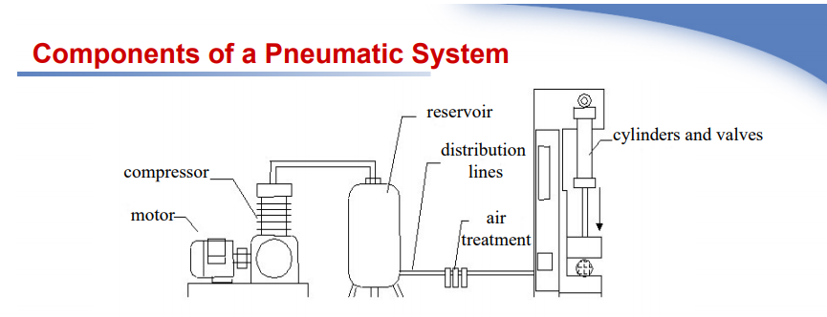

Slide 8
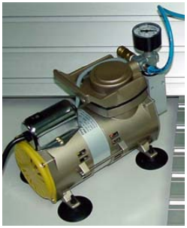
The production and transportation of compressed air Examples of components that produce and transport compressed air include compressors and pressure regulating components.
(a) Compressor A compressor can compress air to the required pressures. It can convert the mechanical energy from motors and engines into the potential energy in compressed air (Fig. 1). A single central compressor can supply various pneumatic components with compressed air, which is transported through pipes from the cylinder to the pneumatic components.

Slide 9
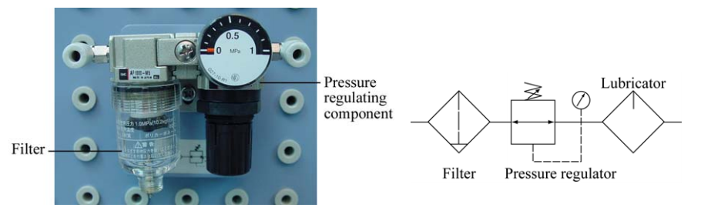
(b) Pressure regulating component Pressure regulating components are formed by various components, each of which has its own pneumatic symbol:
(i) Filter – can remove impurities from compressed air before it is fed to the pneumatic components.
(ii) Pressure regulator – to stabilize the pressure and regulate the operation of pneumatic components
(iii) Lubricator – To provide lubrication for pneumatic components

Slide 10
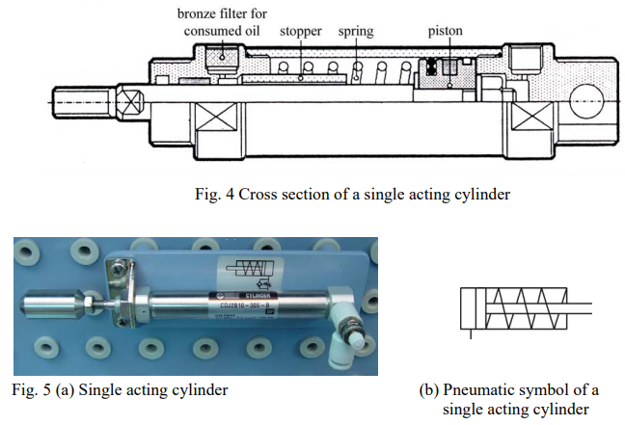
C The consumption of compressed air
Examples of components that consume compressed air include execution components (cylinders), directional control valves and assistant valves.
Examples of pneumatic execution components include cylinder pistons, pneumatic motors, etc. There are many kinds of cylinders, such as single acting cylinders and double acting cylinders.
(i) Single acting cylinder A single acting cylinder has only one entrance that allows compressed air to flow through. Therefore, it can only produce thrust in one direction . The piston rod is propelled in the opposite direction by an internal spring, or by the external force provided by mechanical movement or weight of a load

Slide 11
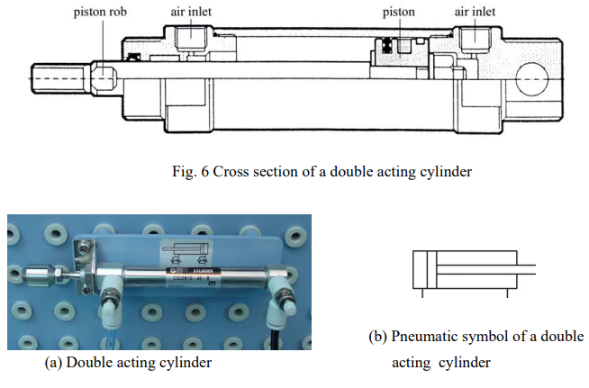
(ii) Double acting cylinder
In a double acting cylinder, air pressure is applied alternately to the relative surface of the piston, producing a propelling force and a retracting force . As the effective area of the piston is small, the thrust produced during retraction is relatively weak. The impeccable tubes of double acting cylinders are usually made of steel. The working surfaces are also polished and coated with chromium to reduce friction.

Slide 12
Hydraulic system
Pneumatic systems are open systems, always processing new air, and air is simply exhausted to the atmosphere. Hydraulic systems are closed systems, always recirculating the same oil.

Slide 13
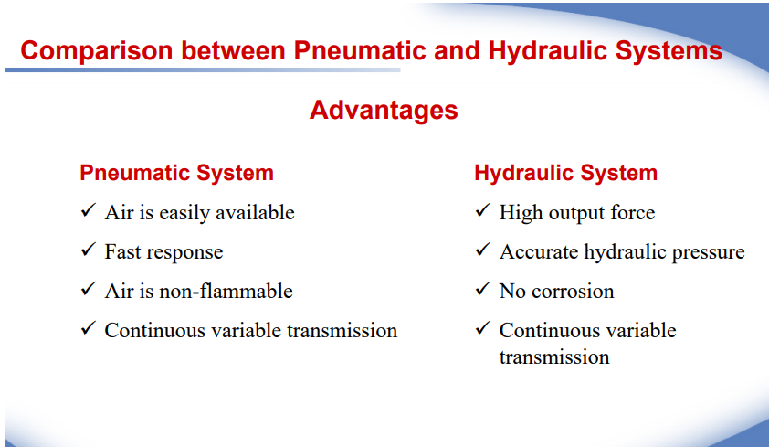

Slide 14
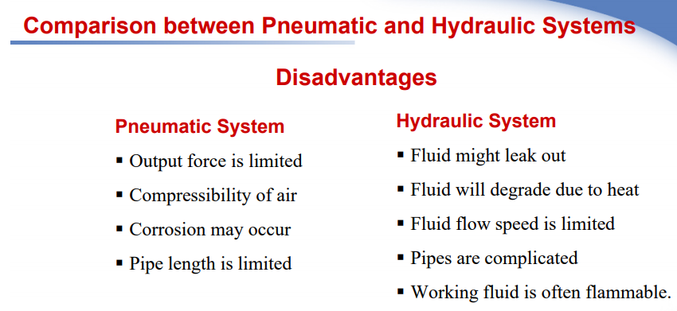

Slide 15
Control valves: are valves used to control conditions such as flow, pressure, and direction of flow.
Pressure control valves.
Flow control valves.
Directional control valves
Check Valves
Directional valves

Slide 16
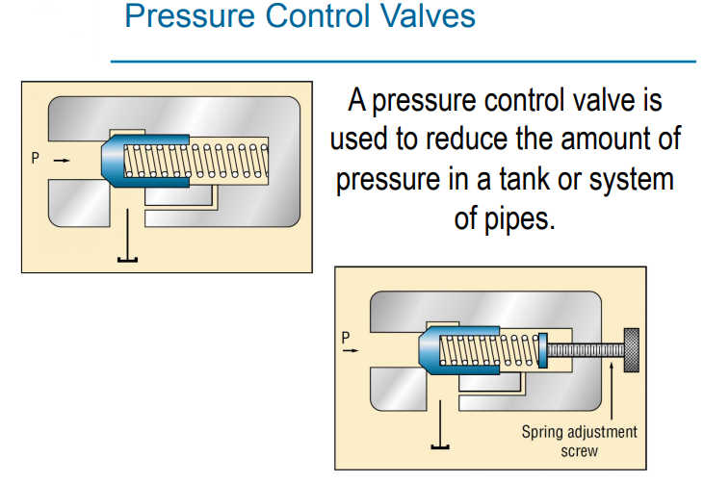

Slide 17
Pressure relief valve
The direct type of relief valve has two basic working port connection. One port is connected to pump and the other to the tank. The valve consists of a spring chamber ( control chamber ) with an adjustable bias spring which pushes the poppet to its seat, closing the valve. A small opening connecting the tank is provided in the control chamber to drain the oil that may collected due to leakage, thereby preventing the failure of valve. System pressure opposes the poppet, which is held on its seat by an adjustable spring. The adjustable spring is set to limit the maximum pressure that can be attained within the system. The poppet is held in position by spring force plus the dead weight of spool. When pressure exceeds this force, the poppet is forced off its seat and excess fluid in the system is bypassed back to the reservoir. When system pressure drops to or below established set value, the valve automatically reseats. Figure shows a direct pressure relief valve..

Slide 18
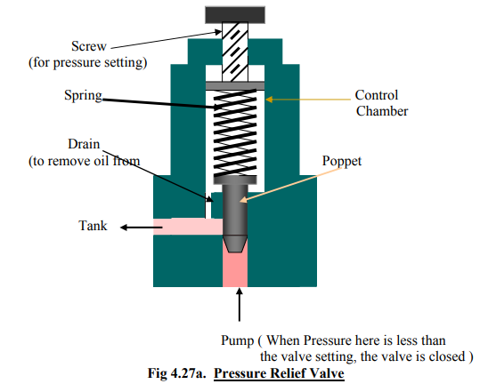

Slide 19
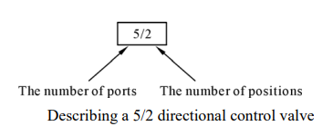
Directional control valve
Directional control valves ensure the flow of air between air ports by opening, closing and switching their internal connections. Their classification is determined by the number of ports, the number of switching positions, the normal position of the valve and its method of operation. Common types of directional control valves include 2/2, 3/2, 5/2, etc. The first number represents the number of ports; the second number represents the number of positions. A directional control valve that has two ports and five positions can be represented by the drawing in Figure, as well as its own unique pneumatic symbol.

Slide 20
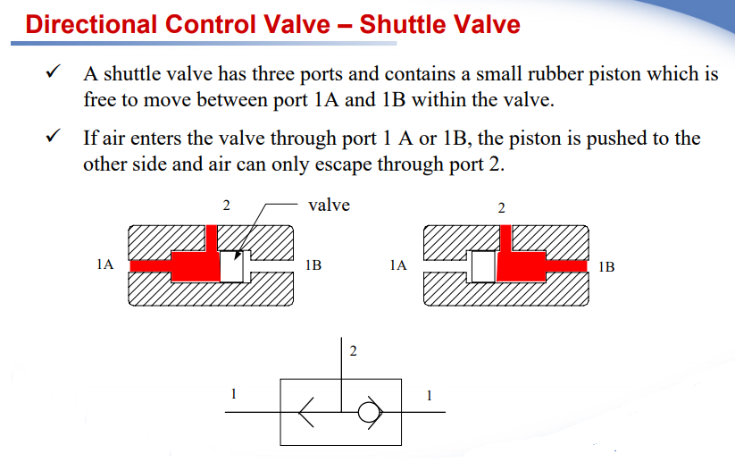

Slide 21
Solenoid valve
A solenoid valve is an electromechanical controlled valve. The valve features a solenoid, which is an electric coil with a movable ferromagnetic core in its center. This core is called the plunger. In rest position, the plunger closes off a small orifice. An electric current through the coil creates a magnetic field. The magnetic field exerts a force on the plunger. As a result, the plunger is pulled toward the center of the coil so that the orifice opens. This is the basic principle that is used to open and close solenoid valves.
"A solenoid valve is an electromechanical actuated valve to control the flow of liquids and gases."

Slide 22
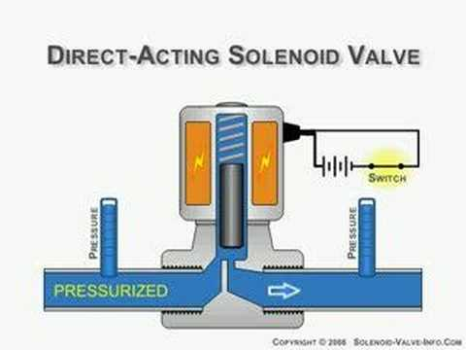

Slide 23
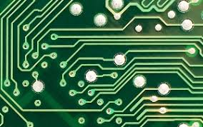
Printed circuit boards
A printed circuit board (PCB) mechanically supports and electrically connects electronic components or electrical components using conductive tracks, pads and other features etched from one or more sheet layers of copper laminated onto and/or between sheet layers of a non-conductive substrate. Components are generally soldered onto the PCB to both electrically connect and mechanically fasten them to it

Slide 24
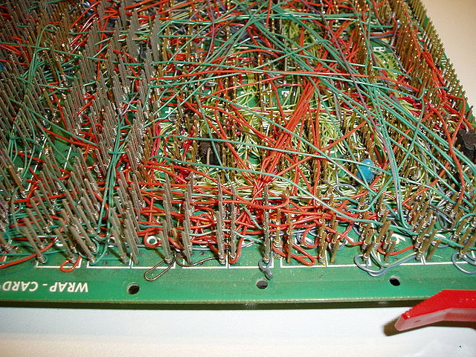
Printed circuit board is the most common name but may also be called “printed wiring boards” or “printed wiring cards”. Before the advent of the PCB circuits were constructed through a laborious process of point-to-point wiring. This led to frequent failures at wire junctions and short circuits when wire insulation began to age and crack.

Slide 25
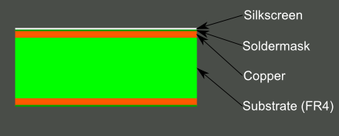
Composition
A PCB is sort of like a layer cake or lasagna- there are alternating layers of different materials which are laminated together with heat and adhesive such that the result is a single object.
Let’s start in the middle and work our way out.
FR4
The base material, or substrate, is usually fiberglass. Historically, the most common designator for this fiberglass is “FR4”. This solid core gives the PCB its rigidity and thickness. There are also flexible PCBs built on flexible high-temperature plastic (Kapton or the equivalent).

Slide 26
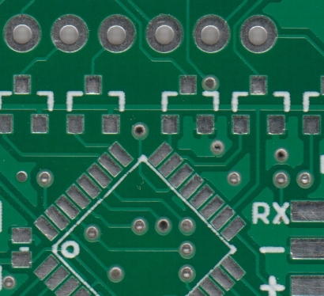
Solder mask
The layer on top of the copper foil is called the solder mask layer. This layer gives the PCB its green (or, at Spark Fun, red) color. It is overlaid onto the copper layer to insulate the copper traces from accidental contact with other metal, solder, or conductive bits. This layer helps the user to solder to the correct places and prevent solder jumpers.
In the example below, the green solder mask is applied to the majority of the PCB, covering up the small traces but leaving the silver rings and SMD pads exposed so they can be soldered to.

Slide 27
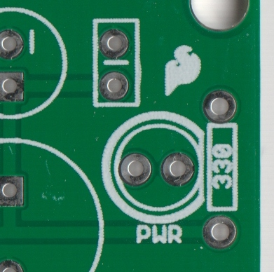
Silkscreen
The white silkscreen layer is applied on top of the solder mask layer. The silkscreen adds letters, numbers, and symbols to the PCB that allow for easier assembly and indicators for humans to better understand the board. We often use silkscreen labels to indicate what the function of each pin or LED.
Silkscreen is most commonly white but any ink color can be used. Black, gray, red, and even yellow silkscreen colors are widely available; it is, however, uncommon to see more than one color on a single board.

Slide 28
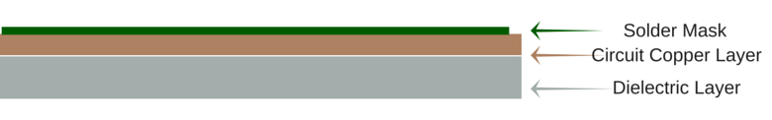
Single Sided PCB
Single Sided PCBs contain only one layer of conductive material and are best suited for low density designs. Single sided PCB’S have been around since the late 1950s and still dominate the world market in sheer piece volume. Single-sided printed circuit boards are easily designed and quickly manufactured. They serve as the most cost effective platform in the industry.
How Are Single Sided PCBs Made?
One thin layer of thermally conductive but electrically insulating dielectric is laminated with copper. Solder mask is usually applied on top. oof
Benefits of Single Sided PCBs
Ideal for simple low-density designs
Lower cost, especially for high volume orders
Lower probability of manufacturing issues
Popular, common, and easily understood by most PCB manufacturers

Slide 29
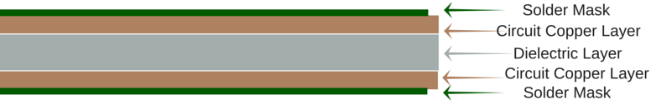
Double Sided PCB
Double Sided PCBs (also known as Double-Sided Plated Thru or DSPT) circuits are the gateway to higher technology applications. They allow for closer (and perhaps more) routing traces by alternating between a top and bottom layer using vias. Today, double sided printed circuit board technology is perhaps the most popular type of PCB in the industry.
How Are Double Sided PCBs Made?
Benefits of Double Sided PCBs:
More flexibility for designers
Increased circuit density
Relatively lower costs
Intermediate level of circuit complexity
Reduced board size (which can reduce costs)

Slide 30
Applications of pcb
The following are applications in which Double Sided PCBs can be used:
Industrial controls
Power supplies
Converters
Control relays
Instrumentation
Regulators
UPS systems
Power conversion
LED lighting

Slide 31
thanks

